Slide 1


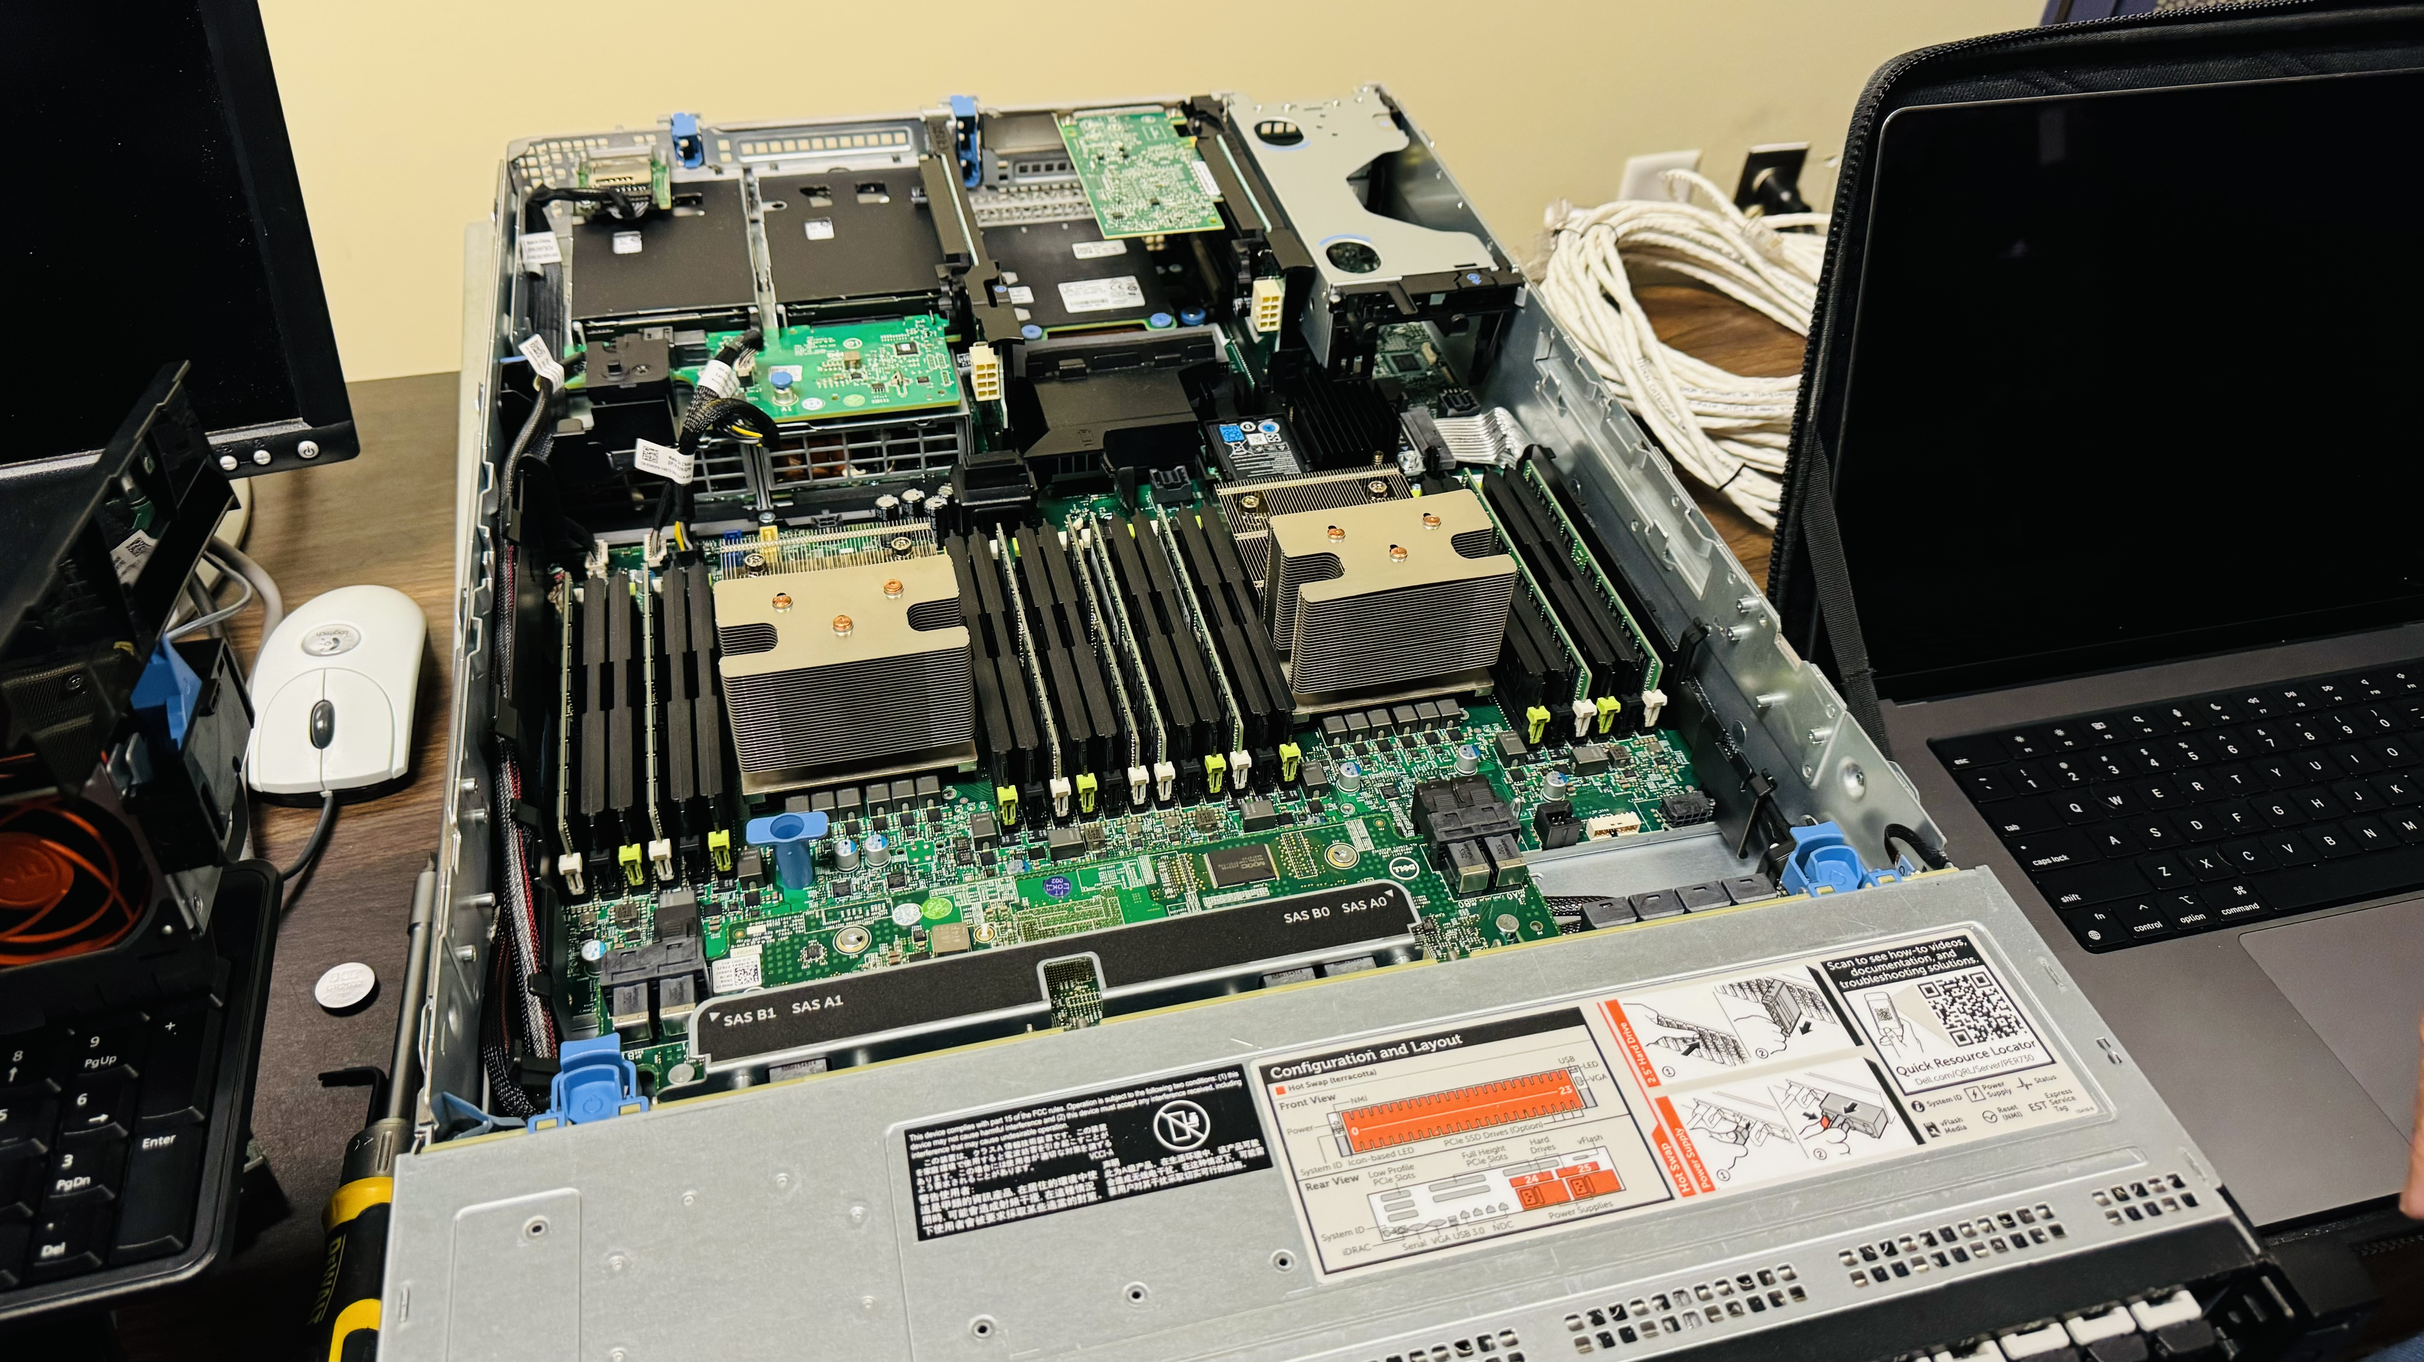






25-310
Advancing HPRC at VCU
Team members: Yunus Bidav, Steven Holcombe, James Jenkins, Amaka Odidaka | Faculty adviser: Alberto Cano, Ph.D. | Sponsor: VCU HPRC Core Laboratory | Mentor: Carlisle Childress
Overview
Key Technologies Utilized
Implementation Steps
Guided by our mentor, Carlisle Childress, our team has completed key modernization steps and outlined future actions:
Completed Steps
Gathered an understanding of basic Linux administration workflows.
Accessed the primary compute cluster for the final installation.
Accessed a server for testing OpenHPC installs via virtual machines.
Finalized initial setup.
Created Warewulf boot images.
Installed all components of the OpenHPC suite.
Updated software infrastructure.
Updated key technologies to their latest releases.
Deployed the install using test hardware.
Deployed compute nodes.
Planned Steps
Test various Slurm workloads.
Validating compatibility.
Deploy High-Performance Linpack software.
Evaluate cluster performance.
Install Open OnDemand
Simplify user access to resources.
Complete install of Infiniband capabilities.
Once testing is complete and all initial issues are documented, scripts will be written to automate the install process for use on production hardware.
The High Performance Research Computing (HPRC) core laboratory at Virginia Commonwealth University (VCU) has been supporting researchers since 2006. HPRC provides access to advanced computational resources, including:
High performance computer clusters
Large CPU, RAM, and storage resources
Specialized tools for scientific computation
Base Operating System Rocky Linux 9.4
Successor of CentOS.
Provides widely used, stable and reliable platform for computational applications.
Web Interface Open OnDemand
Web interface for cluster.
Allows users easy access to compute resources without advanced technical knowledge.
HPC Framework OpenHPC
Provides a suite of commonly used HPC tools.
Greatly simplifies the setup of HPC head nodes.
Provisioning Warewulf
Delivers prebuilt compute node images to hardware over the network, allowing for rapid compute node deployment and updates.
Why Change is Needed
Application Build Systems Spack also (Anaconda, EasyBuild)
Package managers for supercomputers and scientific software.
Allows complex applications to be installed by researchers as needed.
Allows for granular and versatile build and version control.
Containerization Apptainer
Allows for the build and run of containerized applications, even from other containerization systems.
Allows for unprivileged operation (in contrast to Docker).
High performance computing is constantly evolving, but new methods that displace the old tend to introduce disruptive changes. This creates an impetus to rigorously test recent developments to the HPC toolchain before deploying on production clusters.
Additionally, up-to-date documentation and instructions for the latest versions of critical software infrastructure are lacking, making it important to thoroughly document any issues created by changes applied to the various pieces of interacting software.
Addressing these is critical to ensuring stable performance and minimizing downtime for production clusters managed by HPRC.
Cluster Ranking High Performance Linpack
Executes complex algorithms that gauge performance in various aspects.
Ranks the cluster based on relative performance to other clusters.
Workload Manager Slurm
Distributes programs ideally across compute nodes based on the requested resources.

